Slide 1
Understanding Write Behaviors of Storage Backends in Ceph Object Store
Dong-Yun Lee et al.,
IEEE International Conference 2017
2021. 01. 19
Presentation by Sopanhapich CHUM
sopanhapich.chum@gmail.com

Slide 2
Introduction
Background
Evaluation
Conclusions

Slide 3
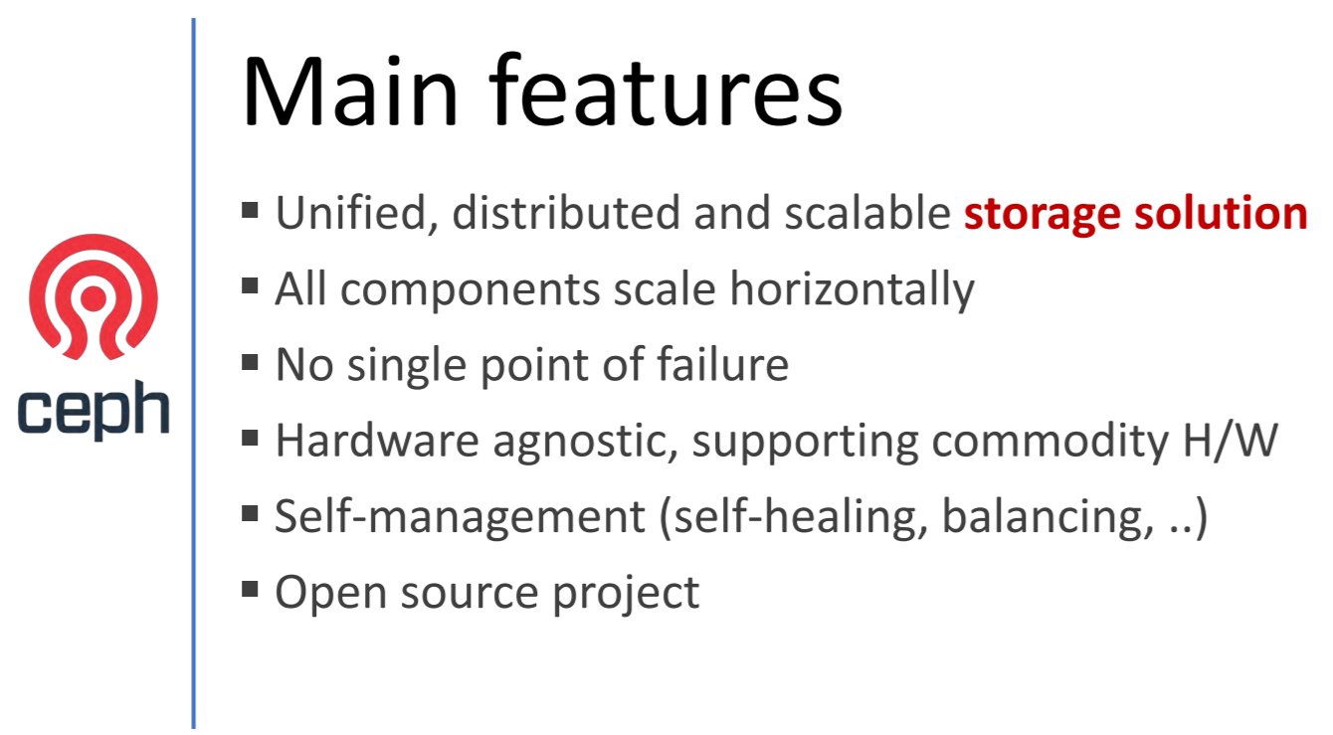
1. Introduction
What is Ceph ?

Slide 4
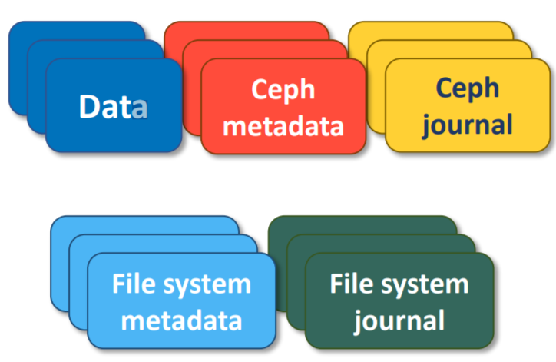

1. Introduction
Introduction
Why the paper focus on write amplification?
WAF (Write Amplification Factor) affects the overall performance
When using SSDs, it hurts the lifetime of SSDs
Larger WAF, the more limited effective bandwidth
Redundant journaling of journal may exist
Single write can make several hidden I/Os

Slide 5
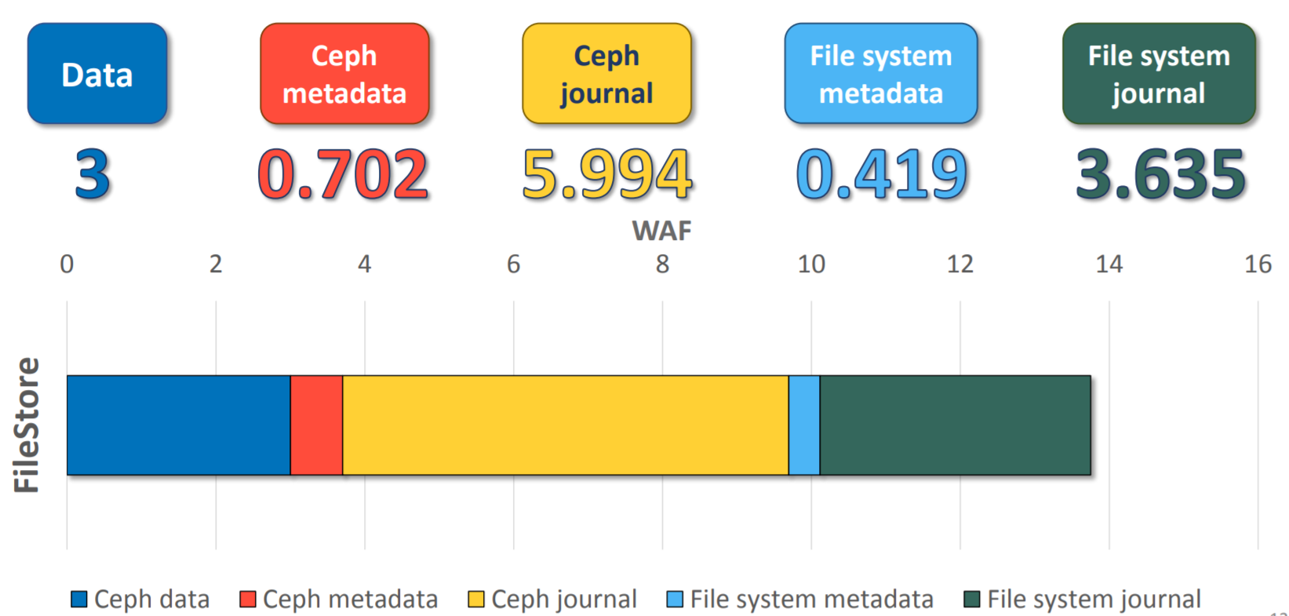
1. Introduction
Introduction
Why ?

Slide 6
1. Introduction
Introduction
Goals of this paper
Understanding of write behaviors of Ceph
FileStore, KStore, BlueStore
Empirical study of write amplification in Ceph

Slide 7
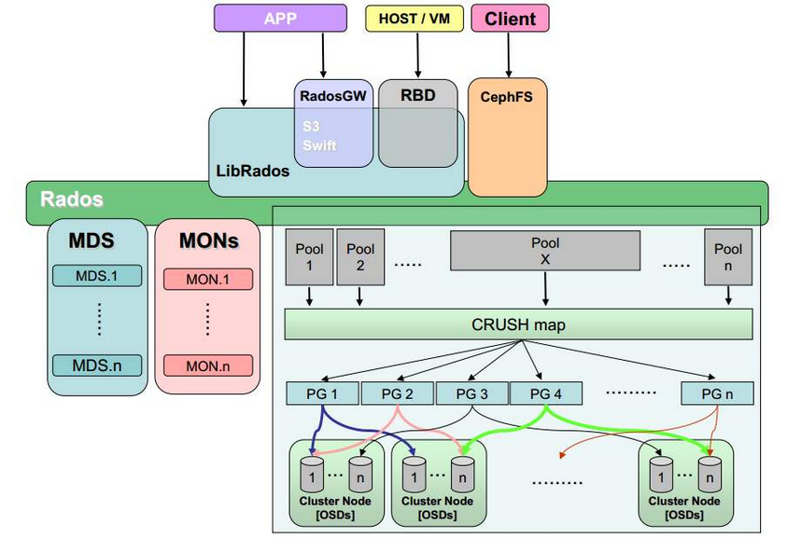
2. Background
Ceph Architecture

Slide 8
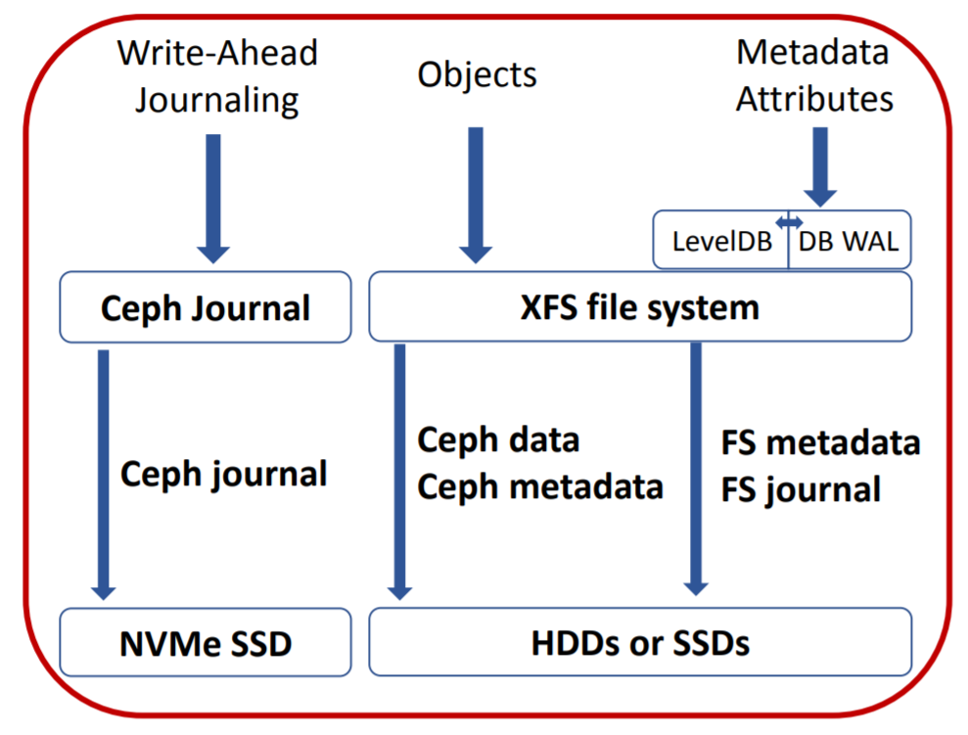
2. Background
Ceph Storage Backends
FileStore
Manages each object as a file
Write flow in FileStore
Write-Ahead journaling
For consistency and performance
Performs actual write to file after journaling
By call writev()
Call syncfs + flush journal
for every 5 seconds

Slide 9
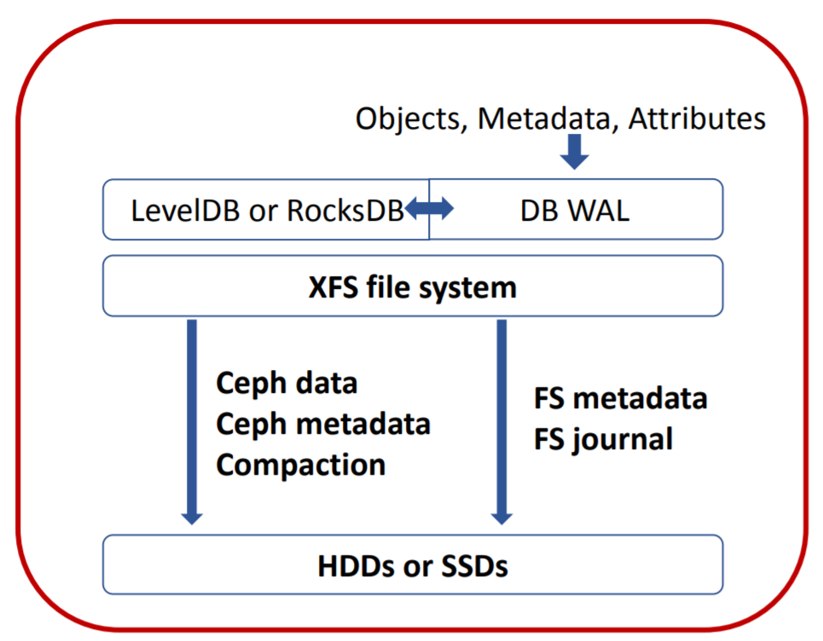
2. Background
Ceph Storage Backends
KStore
Encapsulate everything from object data to their metadata as key-value pairs
Support LevelDB, RocksDB and KineticStorage
Write flow in Kstore
Simply calls key-value APIs with the key-value pair

Slide 10
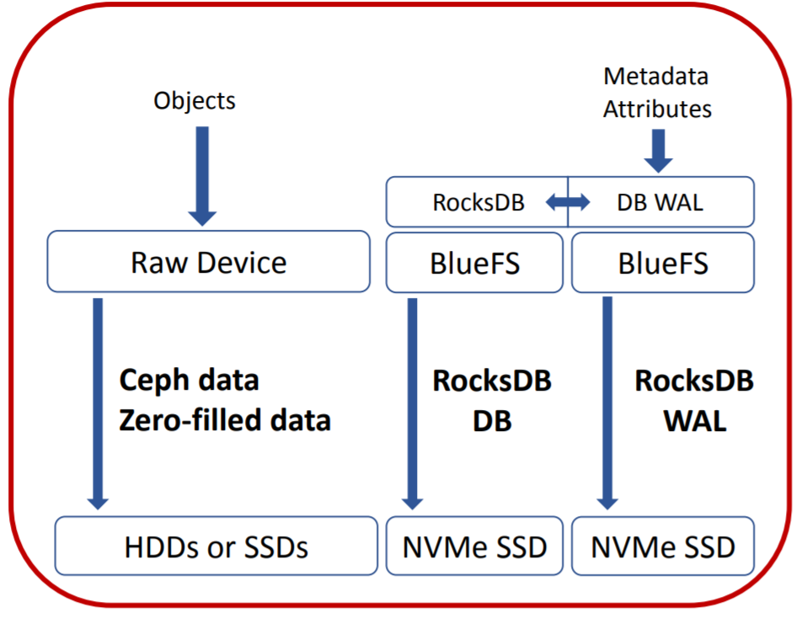
2. Background
Ceph Storage Backends
BlueStore
To avoid limitation of FileStore
Double-write issue
Directly store data to raw device
Write flow in BlueStore
Puts data into raw block device
Sets metadata to RockDB on
BlueFS (user-level file system)

Slide 11
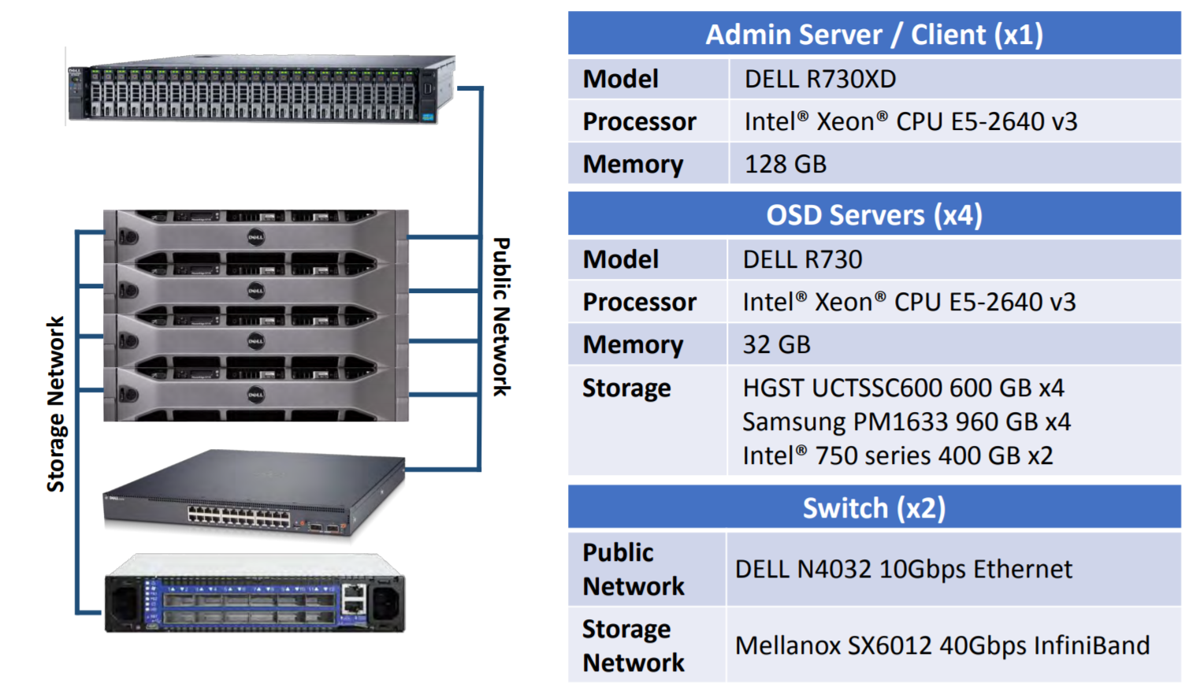
3. Evaluation
Enviroment Setup
Linux 4.4.43 kernel
Ceph Jewel LTS version
Total 16 OSDs
Perform 2 different workload
Micro-benchmark
Long-term workload

Slide 12
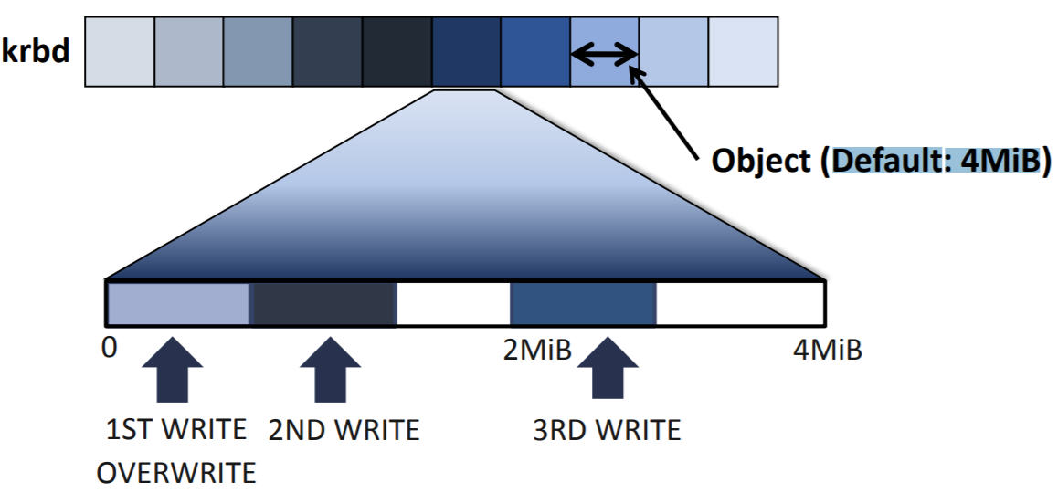
3. Evaluation
Microbenchmark

Slide 13
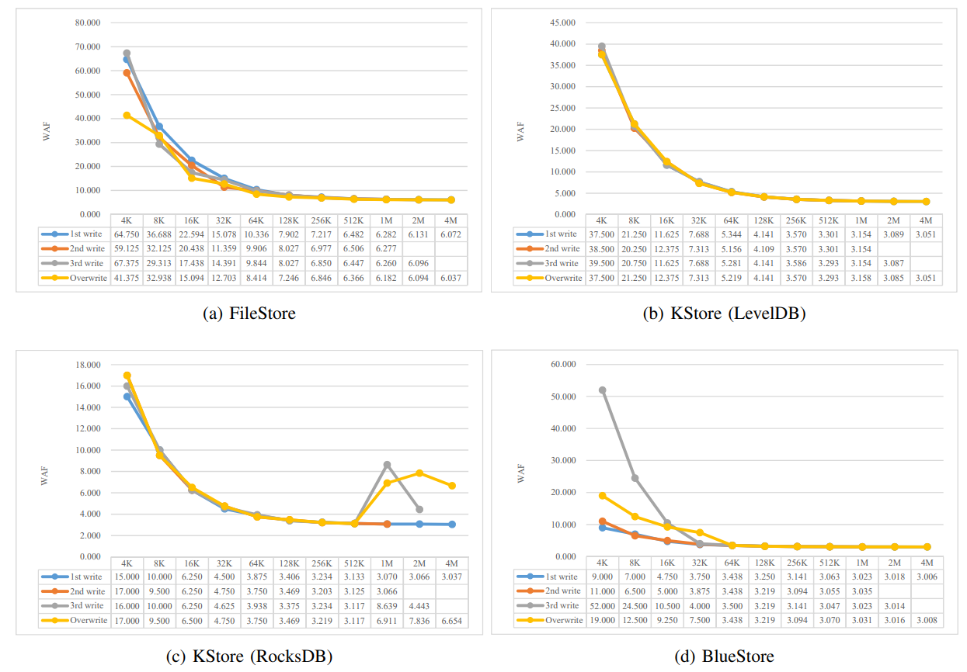
3. Evaluation
Microbenchmark

Slide 14
3. Evaluation
Long-term workload
Workload scenario
Install Ceph and create an empty 64GiB krbd partition
Drop page cache, call sync and wait for 600 seconds to flush all the dirty data to the disk
Perform 4KiB random writes with the queue depth = 128 until the total writes amount reaches 90% of the capacity (57.6GiB)

Slide 15
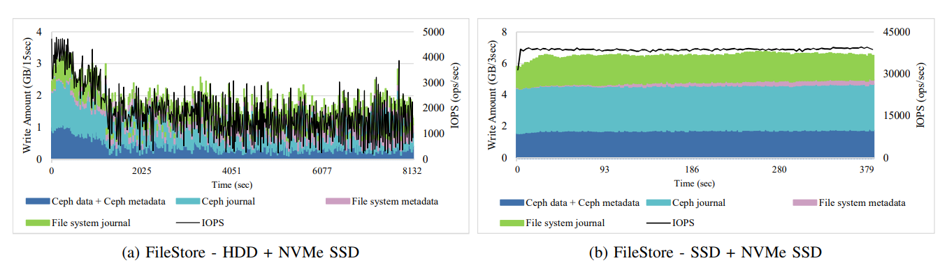
3. Evaluation
Long-term workload

Slide 16
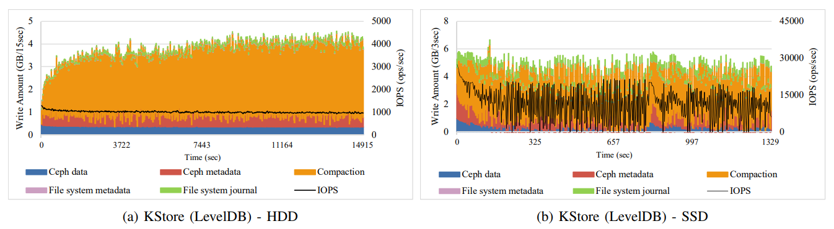
3. Evaluation
Long-term workload

Slide 17
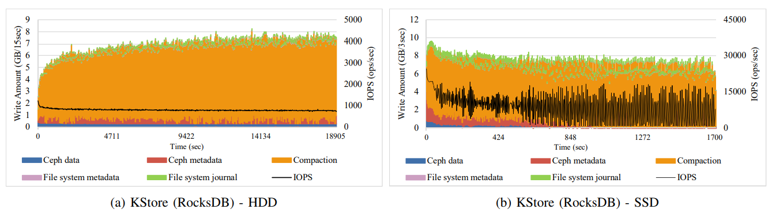
3. Evaluation
Long-term workload

Slide 18
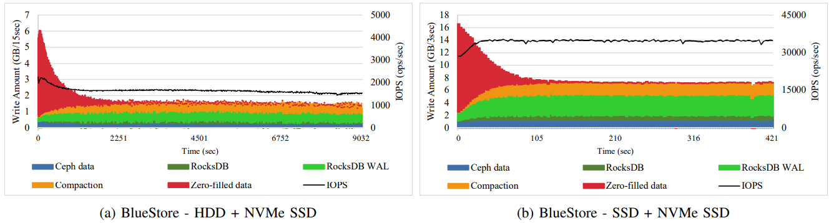
3. Evaluation
Long-term workload

Slide 19
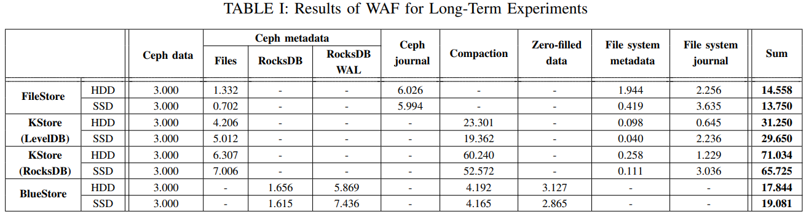
3. Evaluation
Long-term workload

Slide 20
3. Conclusion
Long-term workload
This presentation mainly analyzes write behaviors and the performance of Ceph storage backend focusing on WAF
Result of experiment find that write are amplified by more than 13x in Ceph
Triples write traffic in FileStore due to its own external Ceph journaling

Slide 21
Understanding Write Behaviors of Storage Backends in Ceph Object Store
Miryeong Kwon et al.,
USENIX FAST, 2020
Thank You!
2020. 06. 08
Presentation by sopanhapich CHUM
sopanhapich.chum@gmail.com

